Slide 1
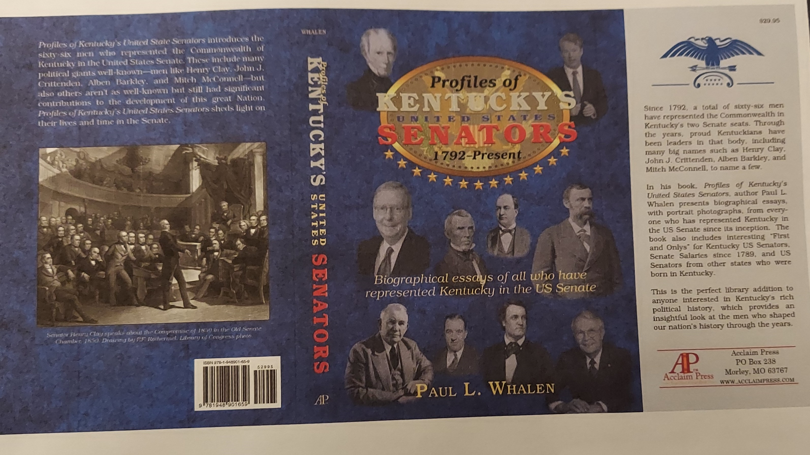
CAMPBELL COUNTY LIBRARY Thursday, August 17, 2023
Profiles of Kentucky’s US Senators, 1792-Present, by Paul L. Whalen

Slide 2
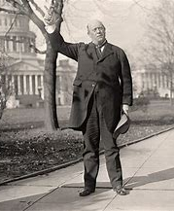
Welcome to this presentation of --Profiles of Kentucky US Senators, 1792-Present
KY U.S. Senator Ollie James (1913-18)

Slide 3
Election site of Kentucky’s First & Second US Senators
This marker a block south of Rupp Arena on Main Street in Lexington marks the site where the first Kentucky Legislature elected John Brown and John Edwards on
June 18, 1792. The legislature elected U.S. Senators until the enactment
of the 17th Amendment to the U.S. Constitution in 1914.

Slide 4
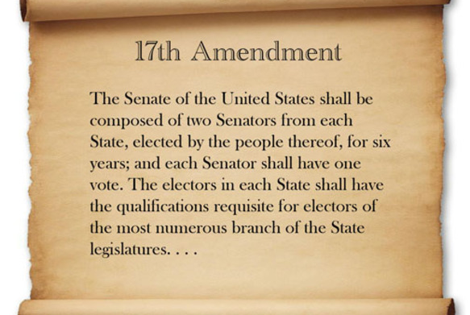
17th Amendment—Direct election of Senators Until 1914, Senators elected by the legislature

Slide 5
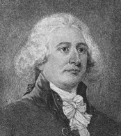
Election Classes
John Brown 1792-1805
Class 2-Elections
Kentucky’s First US Senator
---------------------------------
Mitch McConnell holds Kentucky’s Class 2 Seat—Elections 2020, 2026, 2032

Slide 6
John Edwards Class 3 1792-1795 Kentucky’s 2nd US Senator Elections 2022, 2028, 2034 Senator Rand Paul holds the Class 3 seat.

Slide 7
Senate Turnover From Kentucky was High 1792-1820
1792-1820
Class 2—9 Senators
Class 3—9 Senators
1892-1929
Class 2—7 Senators
Class 3 –6 Senators
1992-2020
Class 2—1 Senators
Class 3—3 Senators

Slide 8
What Happened 1792-1820 ?

Slide 9
Election of US Senators
From 1792 until 1913, Kentucky’s United States Senators were elected by the Kentucky legislature.
The enactment of the 17th Amendment to the U.S. Constitution allowed the election of U.S. Senators by popular vote.
J.C.W. Beckham was the first U.S. Senator elected by popular vote by Kentuckians in 1914.

Slide 10
J.C.W. Beckham-KY’s 1st directly elected US Senator--1914

Slide 11
Where are KY’s U.S. Senators from?
Counties Home to the Most US Senators Since 1792-----
Fayette 7 (Lexington)
Franklin 6 (Frankfort)
Jefferson 6 (Louisville)
Kenton 5 (Covington)
Woodford 4 (Versailles)
Bourbon 4 (Paris)
Warren 4 (Bowling Green)

Slide 12
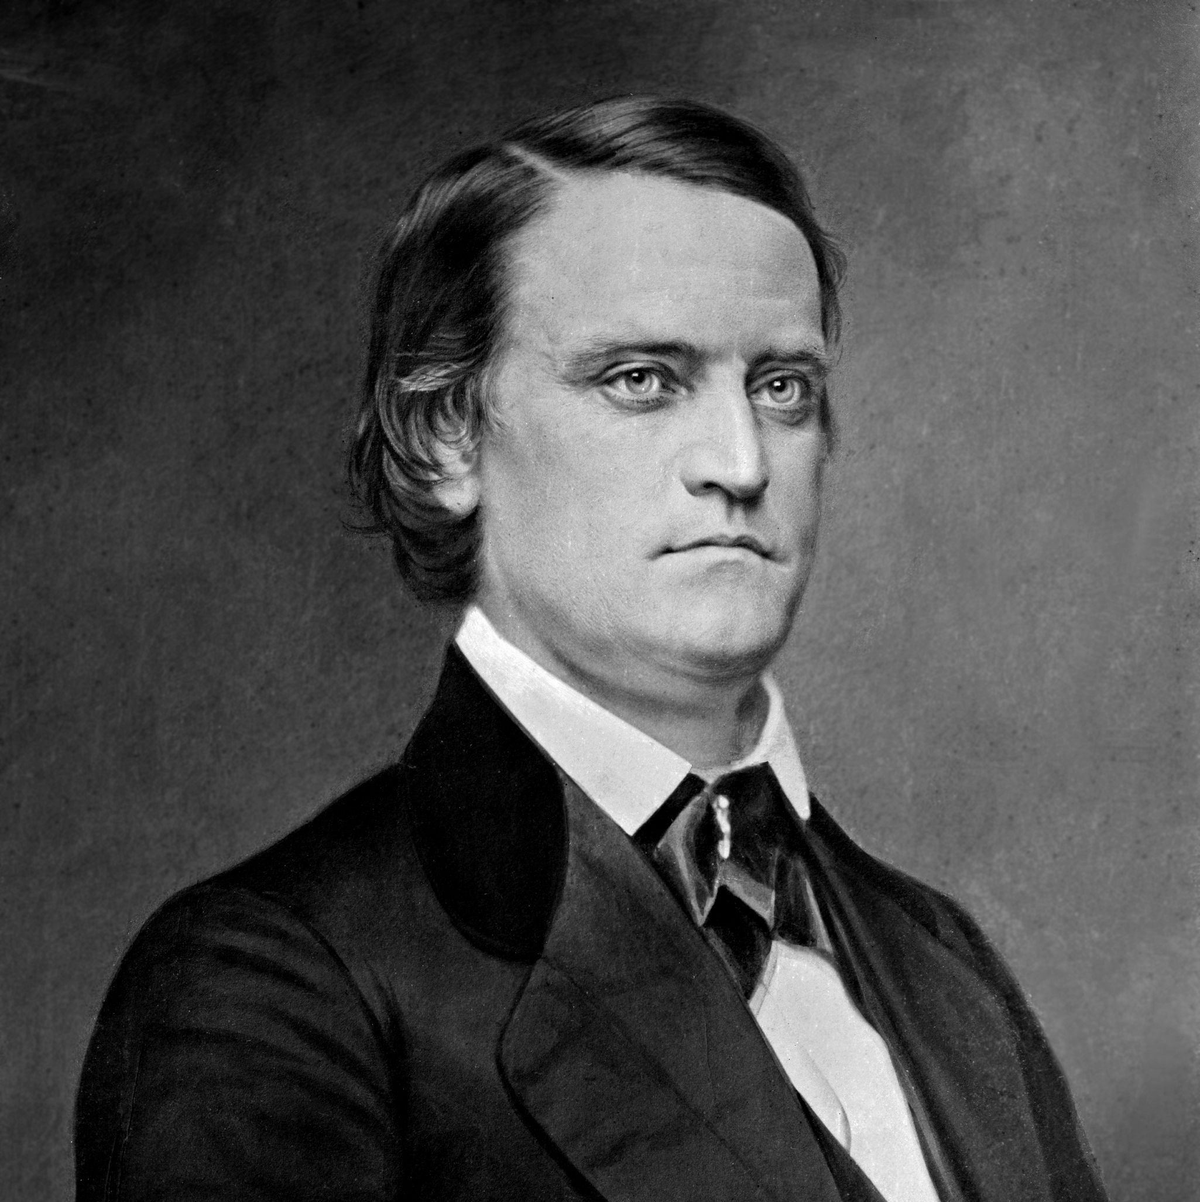
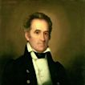
Senators Who Became Vice President

Slide 13
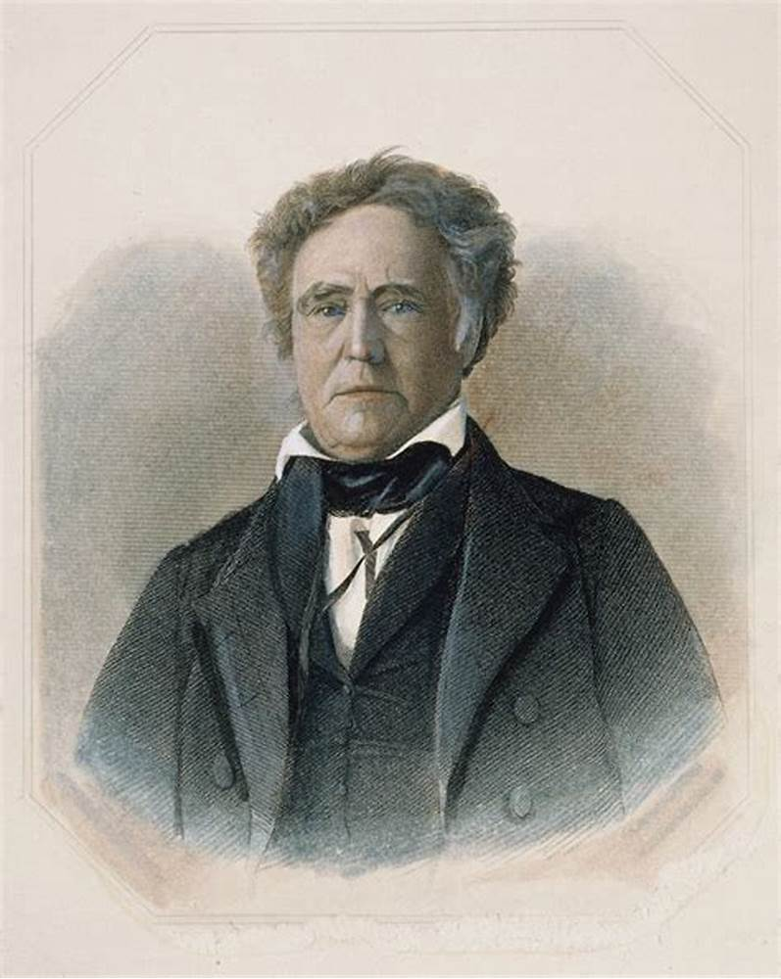
Inauguration of 1837 KY Senator Richard M. Johnson becomes Vice President First of Three Kentucky US Senators to become Vice President

Slide 14
Senators Who Became Vice President
Richard Johnson-----
Hero of War of 1812
Claimed to have Killed Tecumseh
Recognized his black mistress—Julia Chinn and their 2 children
As US Senator championed Sunday Mail Delivery
Founded School in Scott County for Native Americans

Slide 15
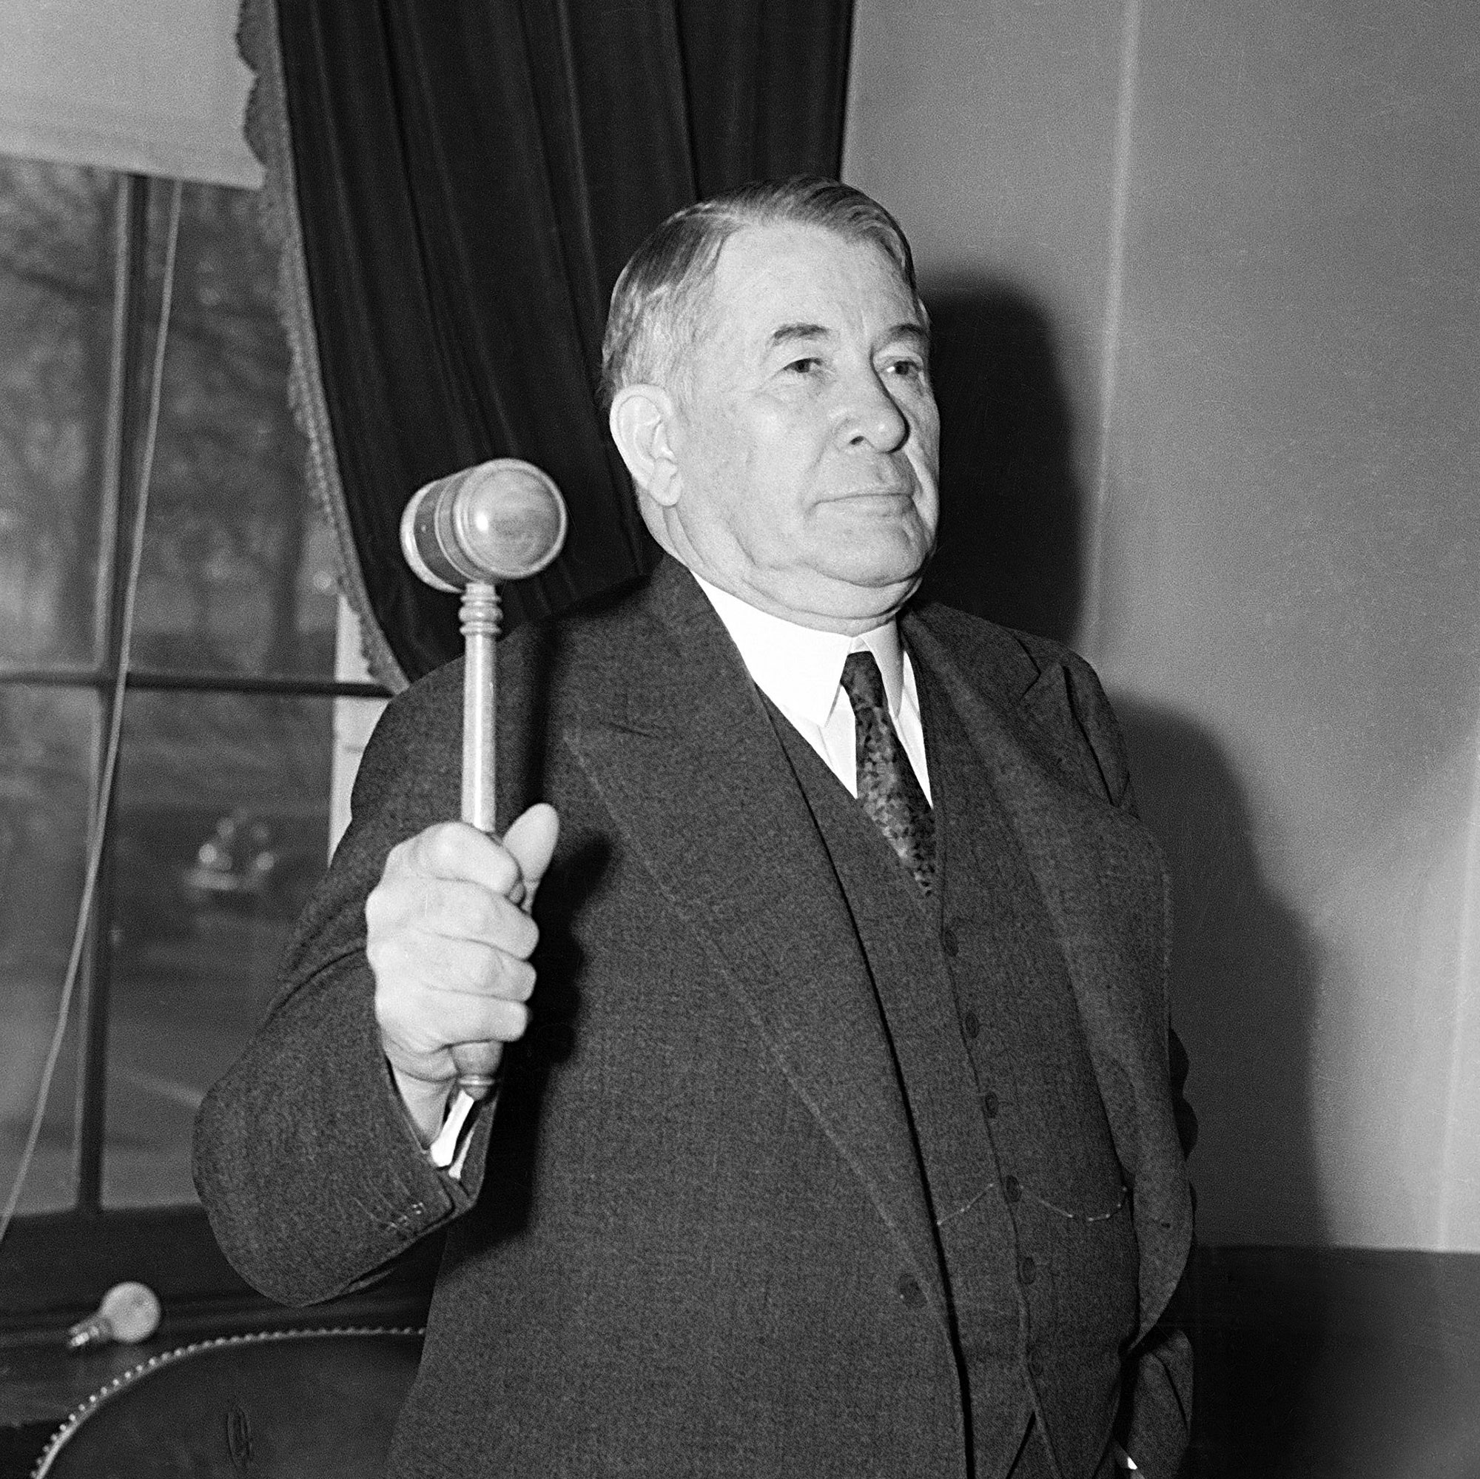
Senators Who Became Vice President
Alben Barkley------
Harry Truman’s Vice President
Was FDR’s Senate Leader for more than 12 years
Served in the House for 14 years in the House
Served in the Senate starting 1928 until becoming VP in 1948
Served in the Senate for almost 2 years after serving as V-P

Slide 16
Three Greatest and One Near Great
Henry Clay ---19th Century
Alben Barkley—20th Century
John Sherman Cooper—Mid 20th Century
Honorable Mention---Stanley—Early 20th Century
Senators within the past 50 years not included--------

Slide 17
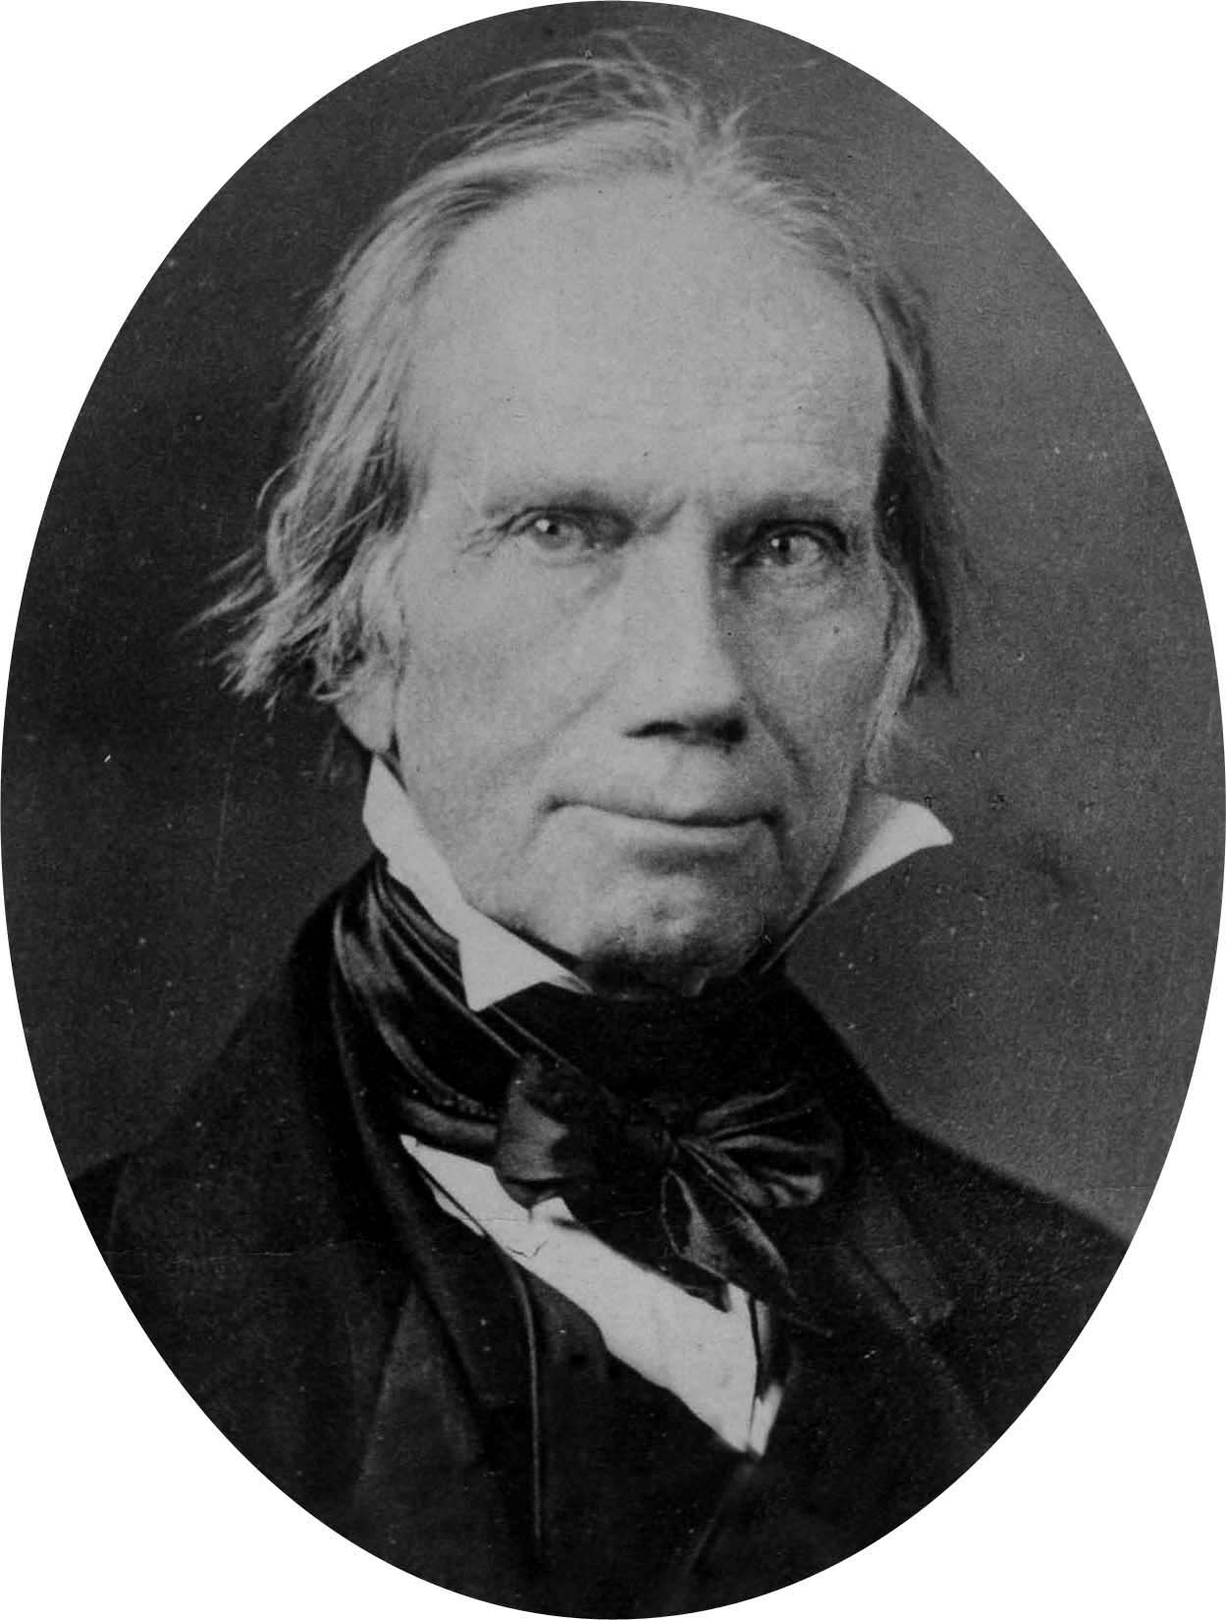
The Greatest KY US Senator—Henry Clay
Speaker of Kentucky General Assembly
Interim US Senator
US Congressman from Lexington
Speaker during his first session of first term
Helped negotiate the peace for the War of 1812
Re-elected and served to 1824
Ran for President in a 4 Person Race in 1824

Slide 18
Henry Clay
Compromise of 1820
Became US Secretary of State under John Quincy Adams 1825
From Lexington
Responsible for Starting and Ending War of 1812
Missouri Compromise (1820)
Compromise 1850

Slide 19
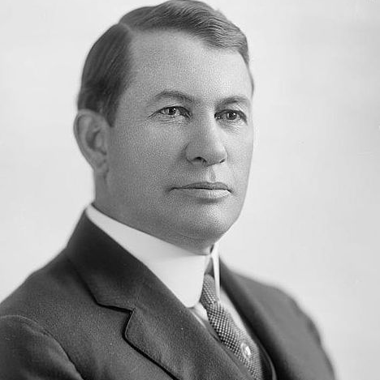
Alben Barkley
Responsible for getting New Deal legislation through Congress
Early advocate of Civil Rights
Tried to eliminate poll tax before end of WWII

Slide 20
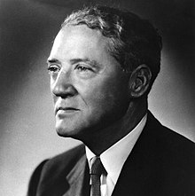
John Sherman Cooper
Republican who supported many New Deal programs
Rural Electrification
Noted for his Foreign Policy Expertise
Ambassador to India
First Ambassador to East Germany

Slide 21
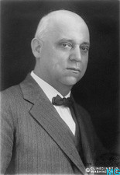
Honorable Mention---A.O. Stanley
Early supporter of Civil Rights
As governor personally stopped a
lynching in Murray, Kentucky
Sponsored legislation which would
require warrants for prohibition
enforcement
Opposed for re-election by Ku-Klux Klan \
and prohibitionists

Slide 22
SENATORS FROM CAMPBELL AND SURROUNDING AREA----
John G. Carlisle born in a section of Campbell before creation of Kenton County
Jim Bunning--Southgate
Richard Ernst –Covington
John W. Stevenson
James T. Morehead

Slide 23
Senators Born In Kentucky Who Represented Other States
40 Men Born In Kentucky Served As Senators of Other States
10 Served as US Senator from the State of Illinois
7 Served as US Senator from Missouri

Slide 24
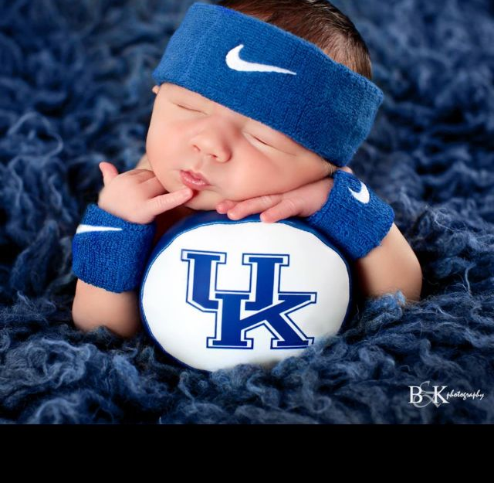
Who was the last KY US Senator born in KY? What was the last county created in Kentucky?

Slide 25
Profiles of Kentucky’s United States Senators 1792-Present
Questions and further information contact---
Paul L. Whalen
113 Ridgeway Avenue
Fort Thomas, Kentucky 41075
859-466-3450
plwhalen@gmail.com
Books available—Acclaim Press, Barnes & Noble, Joseph-Beth, Amazon, Roebling Point Books & Coffee, and other fine bookstores

